Slide 1
Services CPQ Pricing and Costing for Quoting: Roles and Items
January 2025

Slide 2
Pricing: Roles

Slide 3
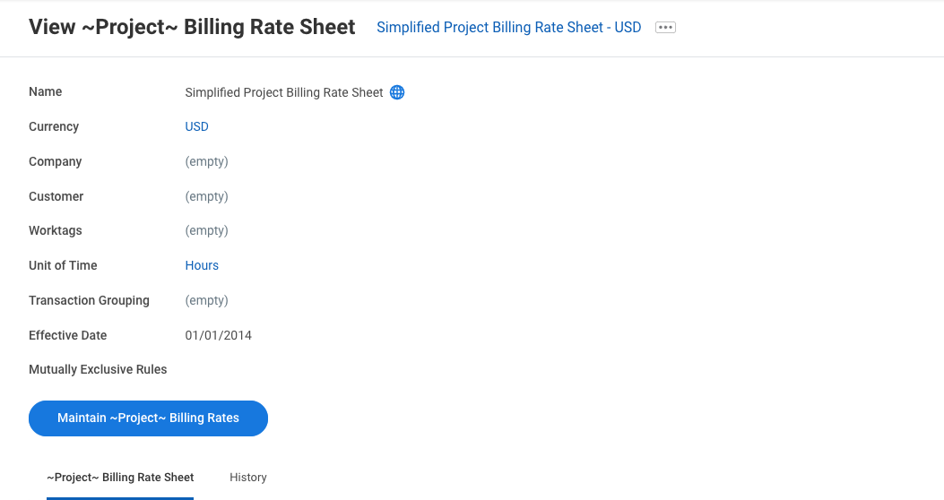
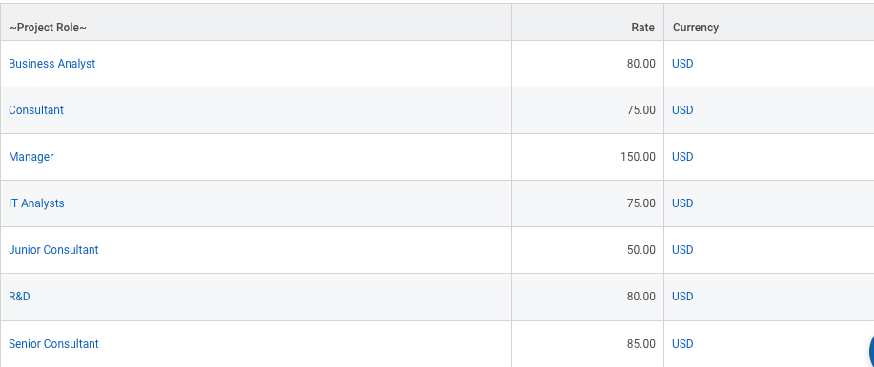
Roles: Set Up Pricing
The unit list price (standard rate) for roles is captured on Project Billing Rate Sheet. You can view, edit, and add Project Billing Rate Sheets in the task: View Project Billing Rates
Project Billing Rate Sheet can be set up by any combination of:
  Currency (required)
  Company
  Customer
  Worktags Types of: Business Unit, Cost Center, Division, Region
  Custom Organizations
One currency is supported per Project Billing Rate Sheet
All other fields above can be multi-select on a Project Billing Rate Sheet (you can specify multiple companies, customers, business units on a single Project Billing Rate Sheet)
One rate per project role is supported on a single Project Billing Rate Sheet

Slide 4
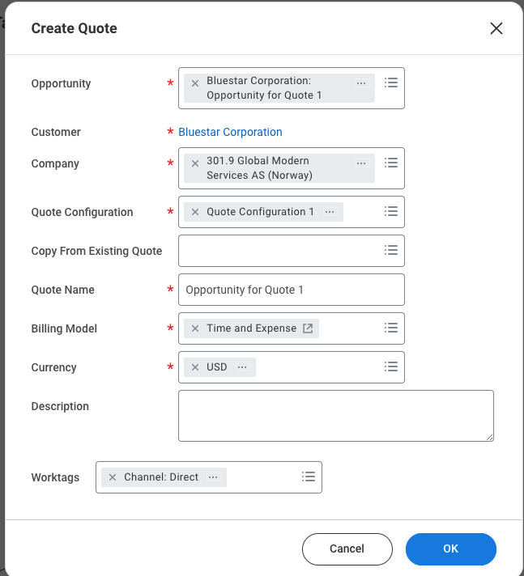
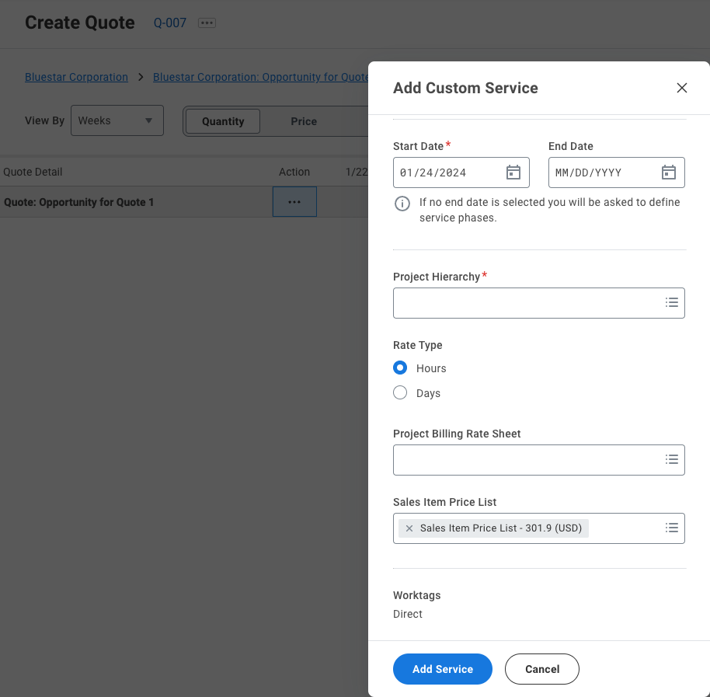
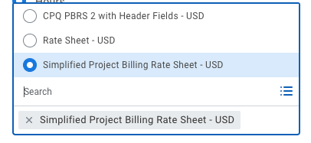
Roles: Pulling in Pricing on Quote
When the quote is created, the user specifies the Opportunity/Customer, Company, Currency, and Worktags for the quote
When the user creates a service on the quote, they have a prompt to select a Project Billing Rate Sheet to price the roles under the service.
Based on the combination of customer, company, worktags specified, the system will filter out any non-applicable Project Billing Rate Sheets from being able to be selected on a service on the quote. If there is a Project Billing Rate Sheet that matches exactly the values on the quote, this value will be defaulted in.

Slide 5
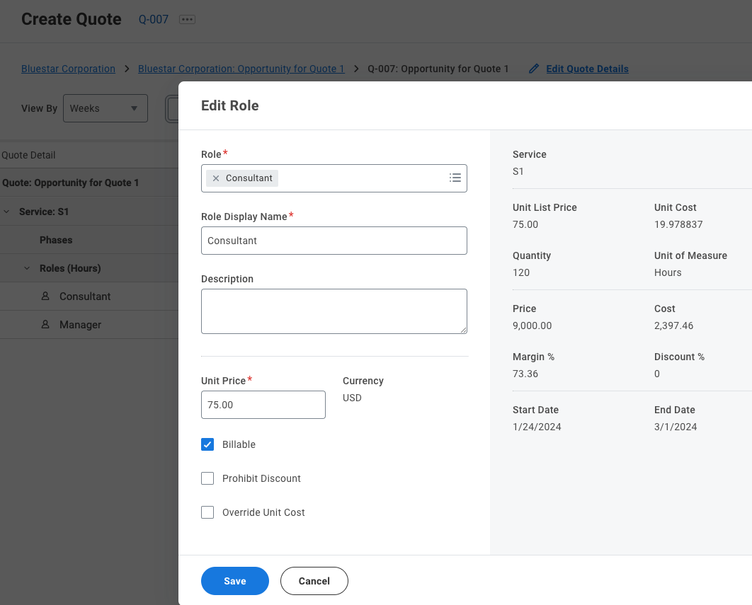
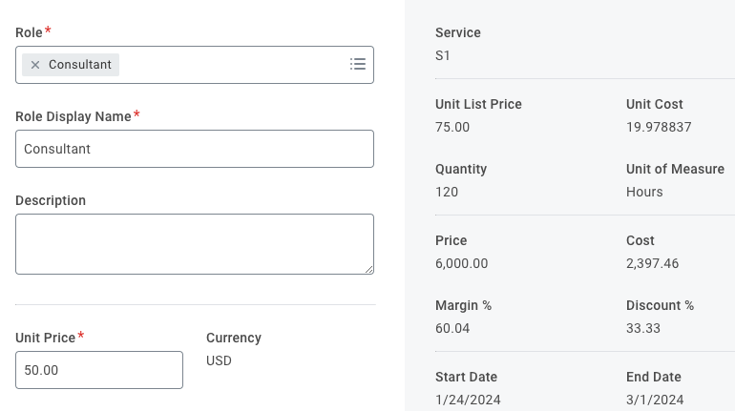
Roles: Pulling in Pricing on Quote
When a role is added to the quote, under this service, the unit list price will default in from the Project Billing Rate Sheet for the service
The role prices can then be manually adjusted or systematically discounted.
The unit list price (standard rate) that defaulted in will be retained, but the unit price will be what the customer will be charged for this role

Slide 6
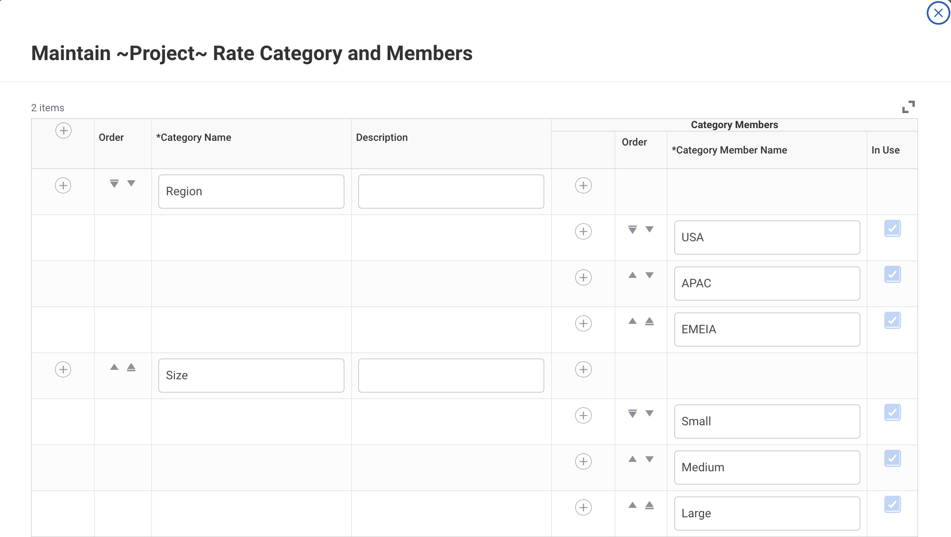
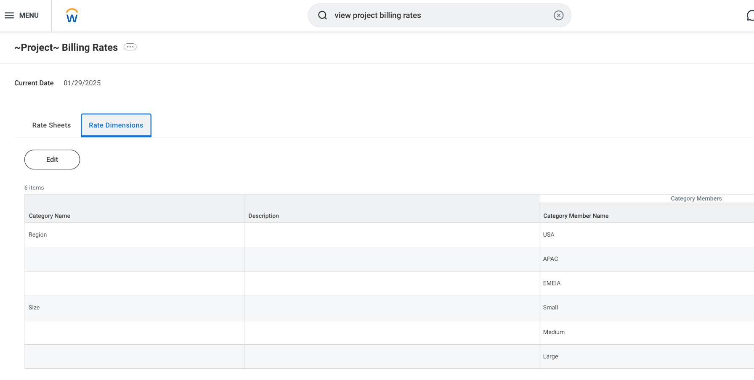
Optional
Rate Categories for
Role Pricing: Set Up
The Project Billing Rate Sheet can be set up with Rate Categories as an optional configuration that allows you to configure more granular defaulting for role prices
You can configure Rate Categories using the task: Maintain Project Rate Category and Members
You can view the Rate Categories from the View Project Billing Rates task under the Rate Dimensions tab
Workday supports a maximum of 5 Categories per tenant (in the example, Region and Size are the Rate Categories)
Note: Rate Categories are used to default in the unit list price for roles on quotes. They are NOT defaulted anywhere else downstream from the quote.

Slide 7
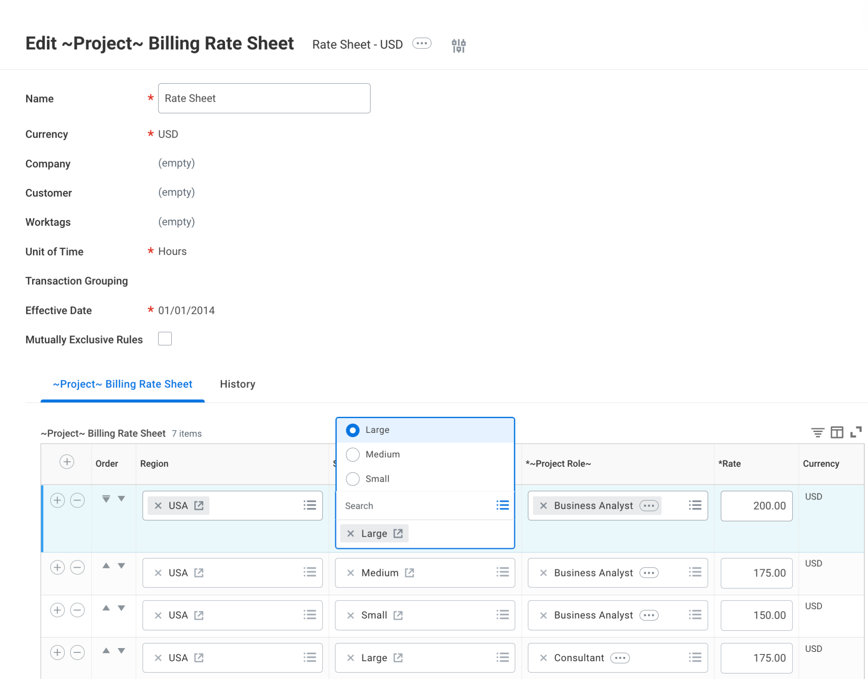
Optional
Rate Categories for
Role Pricing: Set Up
Once you have configured Rate Categories, you can choose these values on a Project Billing Rate Sheet
Rate Categories are optional on the Project Billing Rate Sheet, so you do not need to fill out a rate category for every Project Role if it is not applicable.

Slide 8
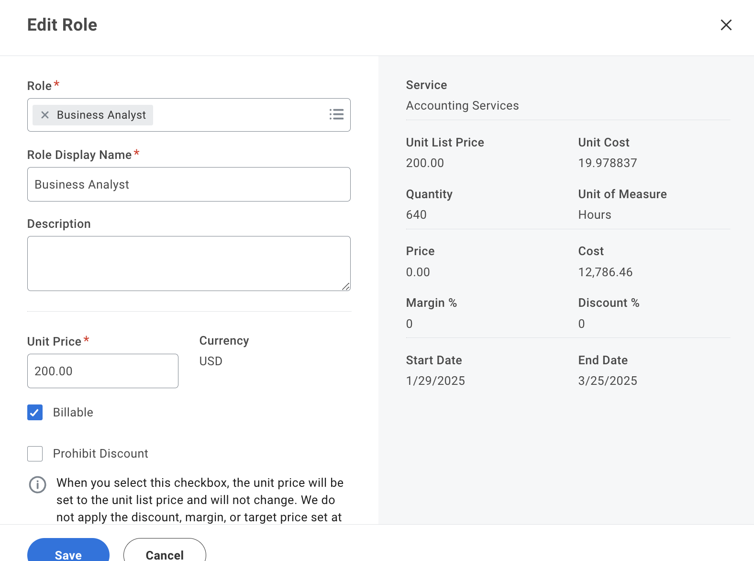
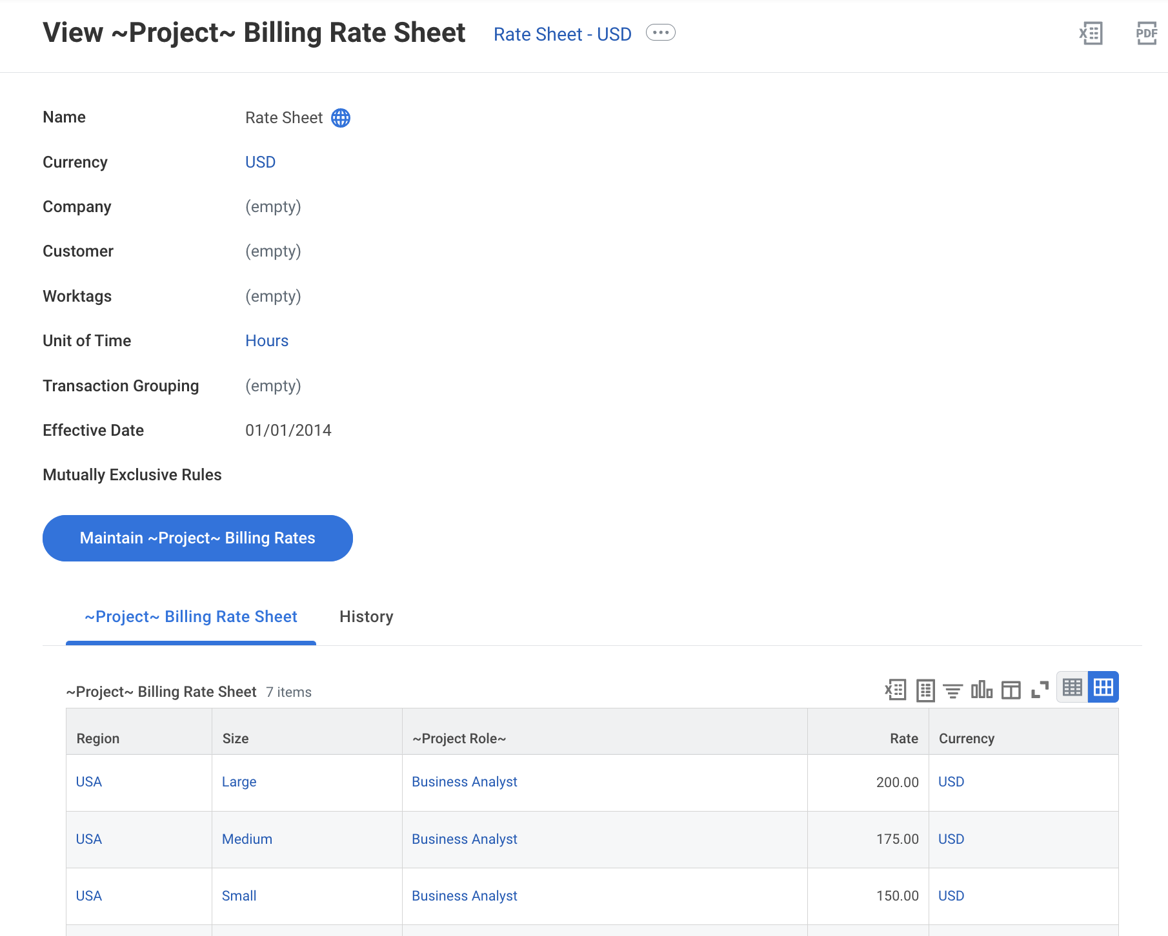
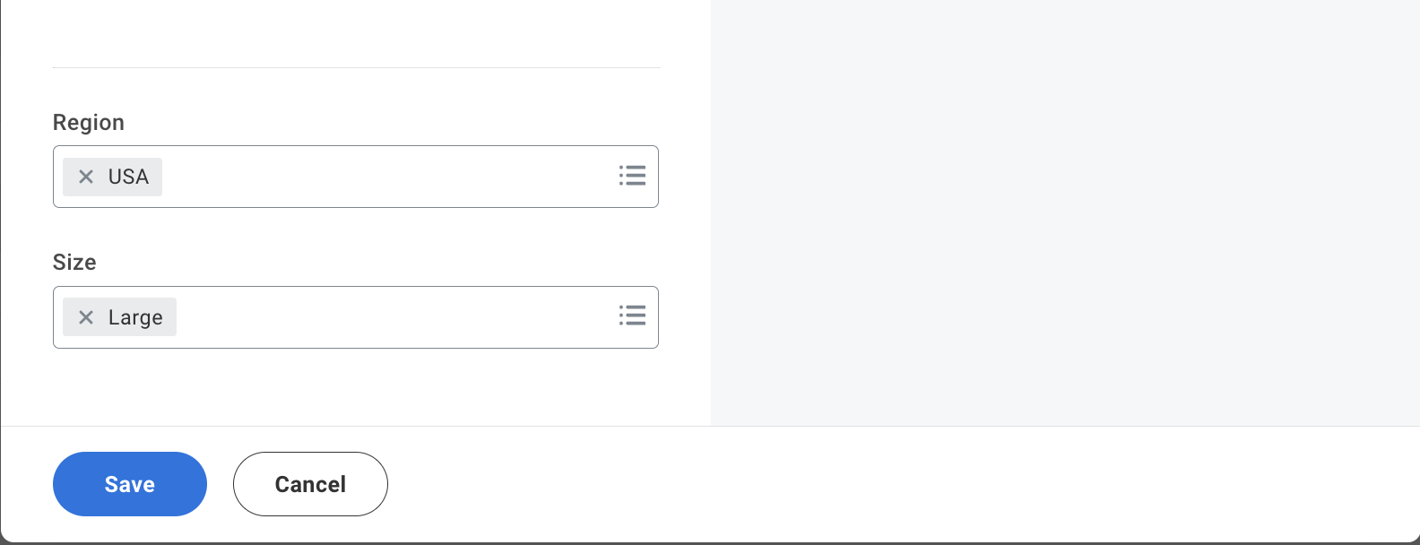
Optional
Rate Categories for Role Pricing: On Quote
When you add a service that has a Project Billing Rate Sheet with Rate Categories, you will see additional prompt fields to enter the Rate Category values when you add or edit a role.
We only display the Rate Categories that are configured on the Project Billing Rate Sheet
We only show the Rate Category values in the prompts that are available options for the role

Slide 9
Cost Estimation: Roles

Slide 10
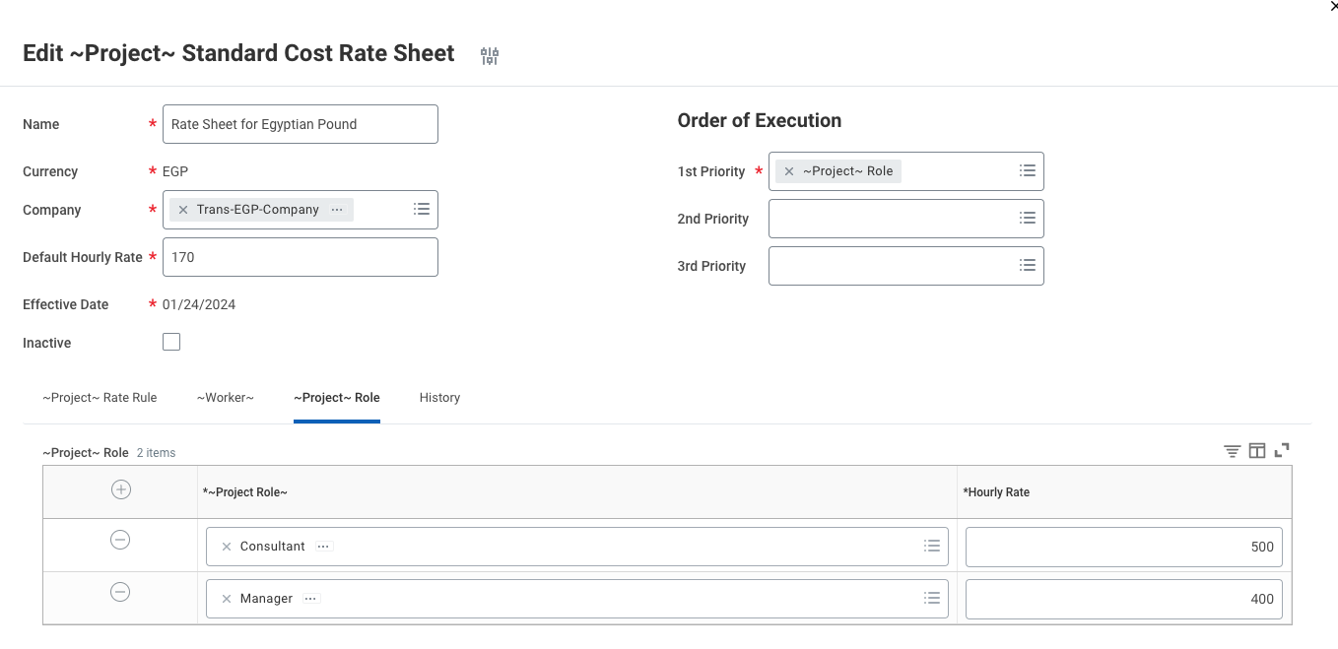
Roles: Set Up Standard Costs
Standard cost rates are pulled from the Standard Cost Rate Sheet
Standard Cost Rate Sheets can be configured for a single company and currency. You can only have one Standard Rate Sheet per company
Standard Hourly rates by Project Role can be entered
A Default Hourly Rate will apply for any roles not listed in the project role table

Slide 11
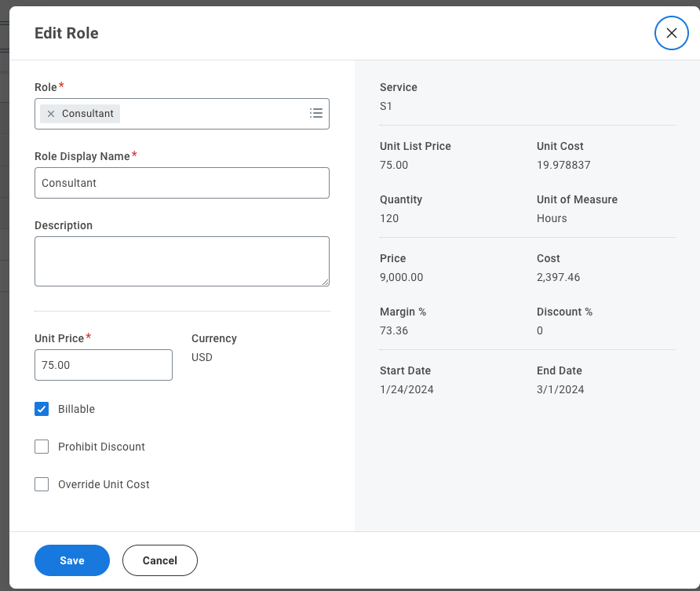
Roles: Pulling in Default Standard Costs
The company on the quote will drive the Standard Cost Rate Sheet that is used for role cost in quoting
The unit cost will default to the hourly rate from the Standard Cost Rate sheet for the role (or the default hourly rate if this role is not specified on the Standard Cost Rate Sheet)
If the quote is in a different currency than the Standard Cost Rate Sheet’s currency, we will convert the unit cost to the quote currency

Slide 12
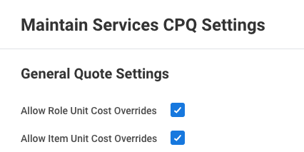
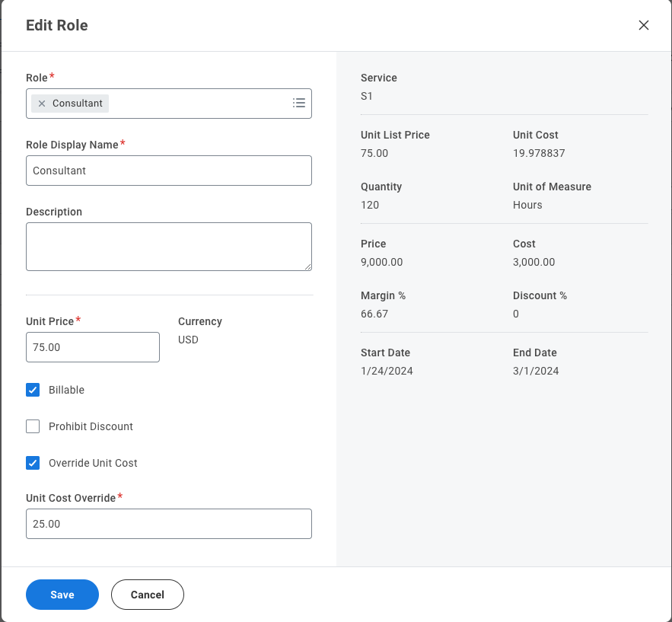
Roles: Default Cost Overrides
Ability to opt in at a tenant level to “allow unit cost overrides.”
If opted in, a checkbox will appear for “Override Unit Cost” for each role. If this box is checked, a “Unit Cost Override” can be entered for the role.
The standard cost (unit cost) that defaulted in will be retained for reporting purposes if needed, but the modified cost (unit cost override) will be the cost used to calculate the margin for this role
  If the “Override Unit Cost” checkbox is checked, the “Cost” field will be the result of Unit Cost Override * Quantity

Slide 13
Pricing: Items

Slide 14
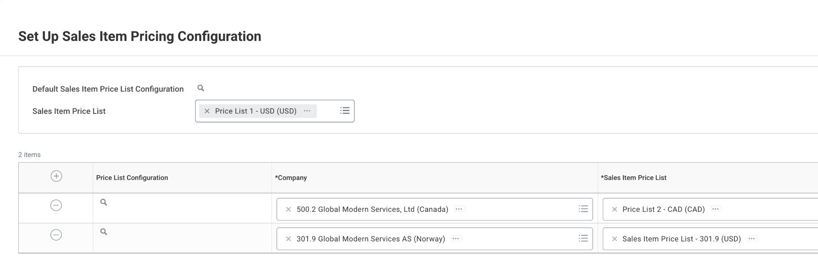
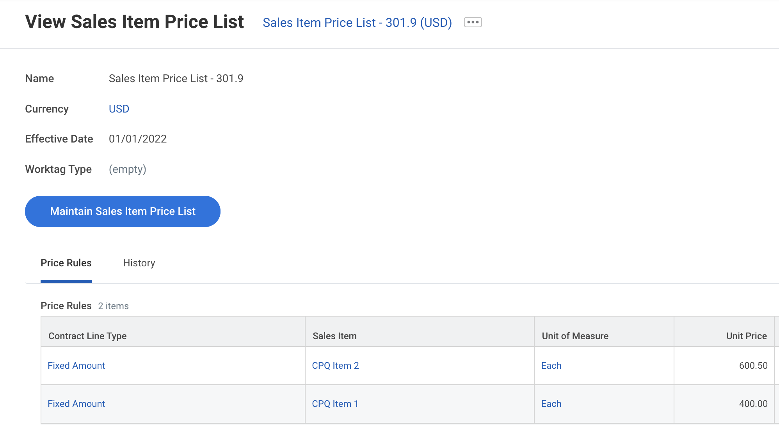
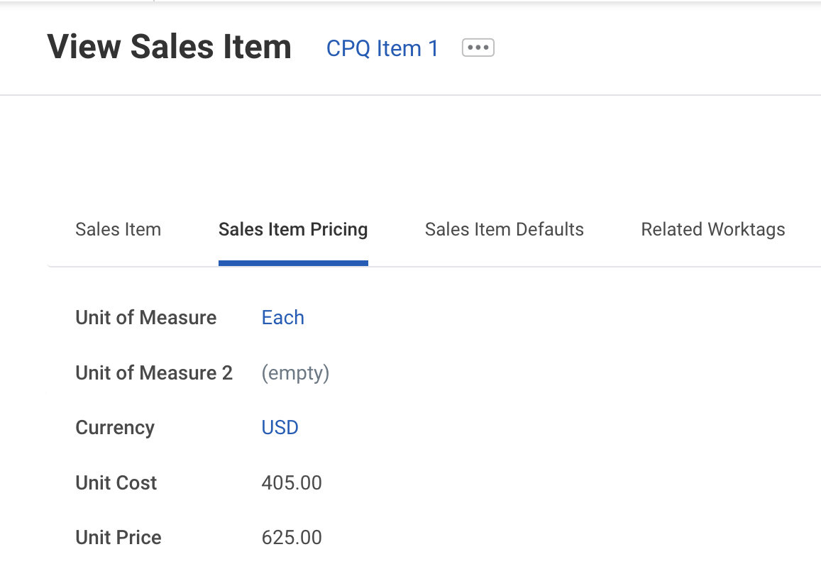
Sales Items: Set Up Pricing
Prices for sales items are captured on the sales item OR on the sales item price list
Sales Item Price Lists are set up by
  Currency (required)
Sales Item Price Lists can be configured to default for a given company (see #1)
If a company does not have a default configured, the tenant default will default in (see #2)
If “Set Up Sales Item Pricing Configuration is not set up or a price is not found, the price will default from the item itself (see #3)
2
1
3

Slide 15
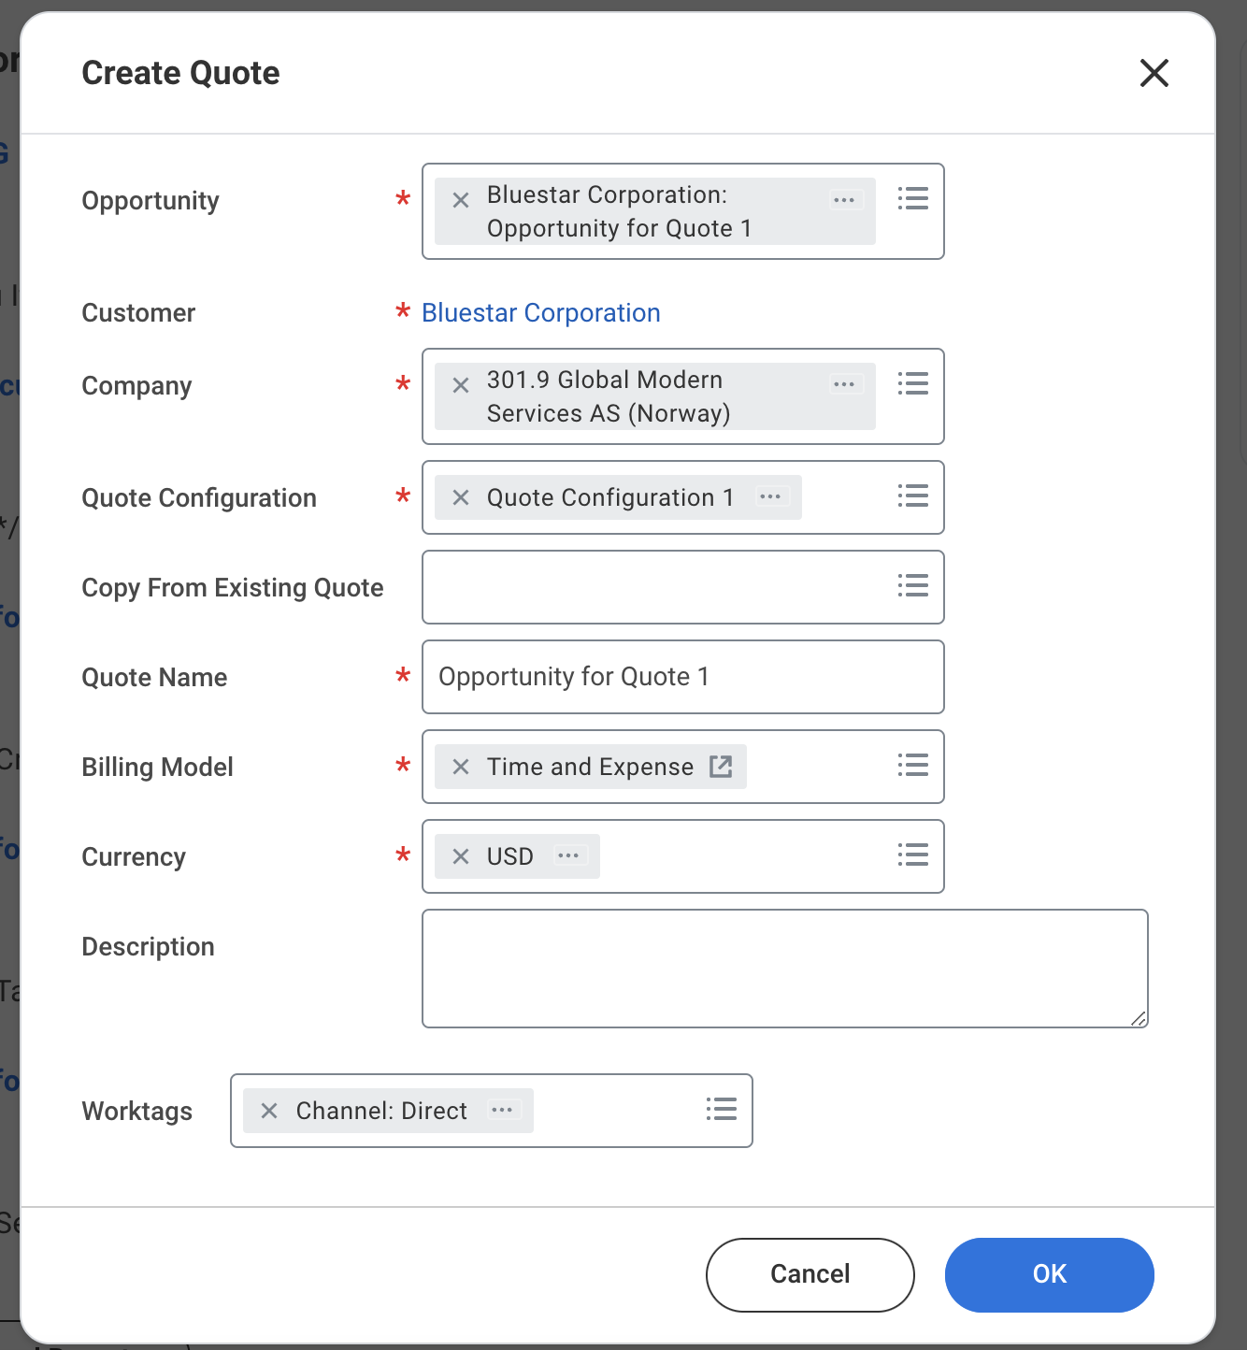
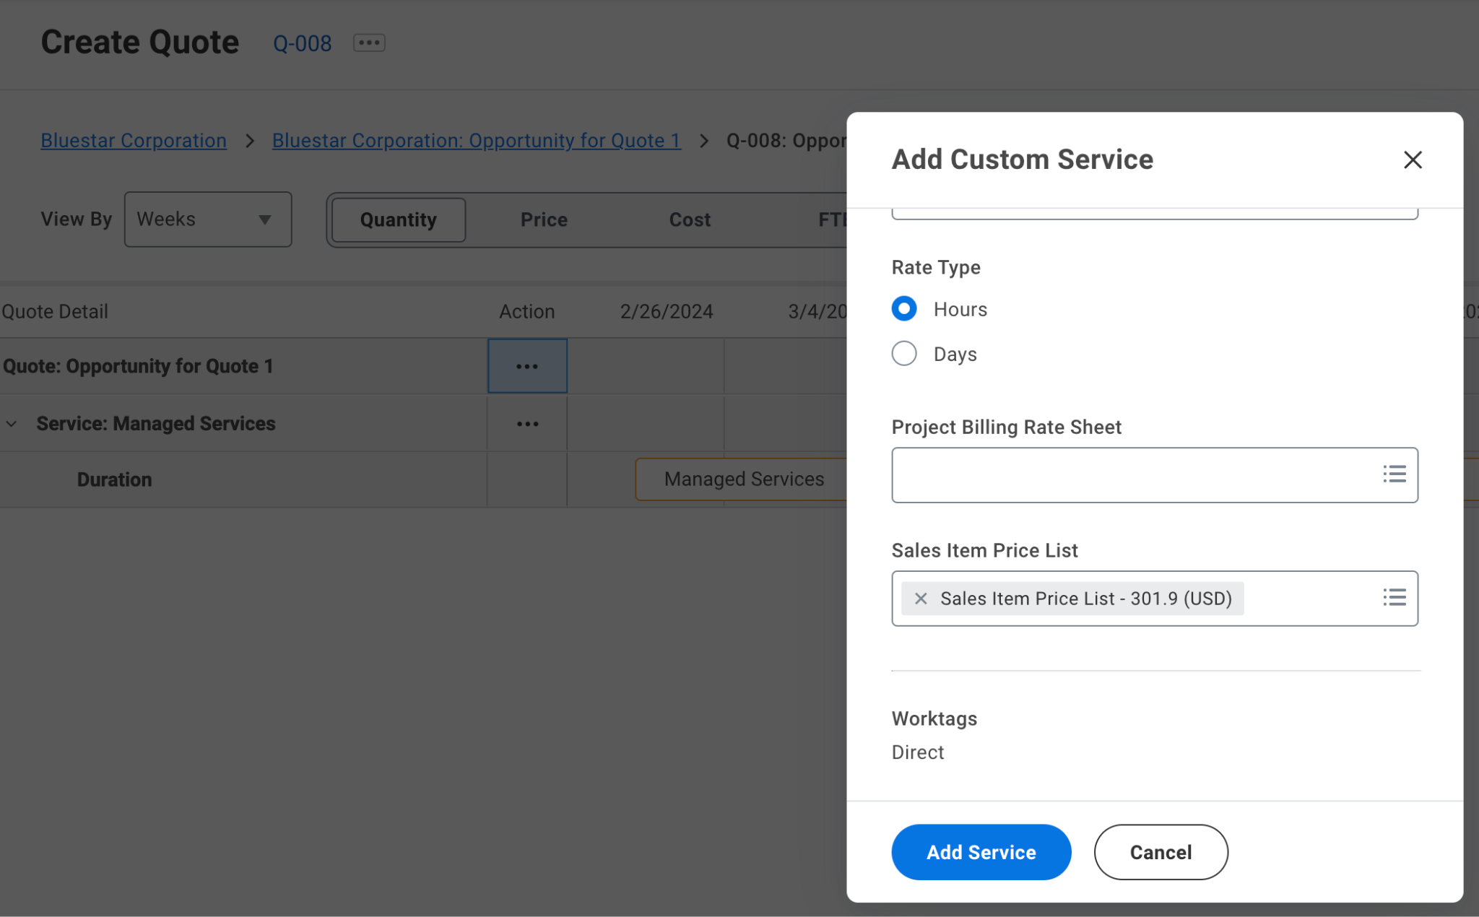
Sales Items: Pulling in Pricing on Quote
If “Set Up Sales Item Pricing Configuration” task is set up, the Company on the quote will be used to default in a Sales Item Price List for any services added on that quote
If “Set Up Sales Item Pricing Configuration” is not for the company, the tenant default Sales Item Price List will default in
If “Set Up Sales Item Pricing Configuration” is not set up at all, then no Sales Item Price List will default in on the service on the quote

Slide 16
Sales Items: Pulling in Pricing on Quote
If there is not a match for a sales item found on the Sales Item Price List for a service, then the price for this item will default in from the sales item configuration
If there is no Sales Item Price List specified for a service, the price for an item added under this service will default in from the sales item configuration

Slide 17
Cost Estimation: Sales Items

Slide 18
Set Up Standard Cost: Sales Items
Sales Item Unit Cost will default from the Unit Cost specified on the Sales item configuration
If unit cost is blank, sales item unit cost will default to 0 on the quote
If the unit cost is in a different currency than the quote currency, the unit cost will be converted to and displayed in the quote currency on the quote

Slide 19
Items: Default Cost Overrides
Ability to opt in at a tenant level to “allow item unit cost overrides.”
If opted in, a checkbox will appear for “Override Unit Cost” for each sales item. If this box is checked, a “Unit Cost Override” can be entered for the sales item.
The standard cost (unit cost) that defaulted in will be retained for reporting purposes if needed, but the modified cost (unit cost override) will be the cost used to calculate the margin for this sales item
  If the “Override Unit Cost” checkbox is checked, the “Cost” field will be the result of Unit Cost Override * Quantity

Slide 20
Unit List Price Overrides: Roles and Items

Slide 21
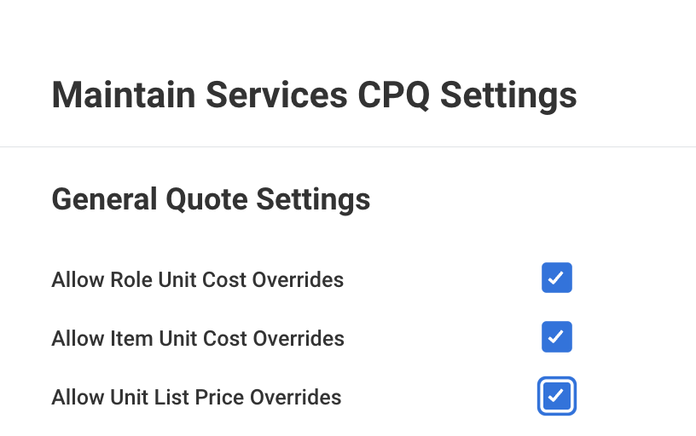
Unit List Price Overrides
We now support the ability to opt into “allow unit list price overrides,” which will allow you to manually enter a unit list price for a role or an item that has a default unit list price of 0
A role or an item will have a unit list price of 0 due to the following scenarios:
  Role (including any rate categories) is not found on the Project Billing Rate Sheet for the service
  Item does not have any price on Sales Item Price List for the service, the default Sales Item Price List for the tenant, or on the Sales Item
  The service does not have a Project Billing Rate Sheet specified
  The service does not have a Sales Item Price List specified, there is no default Sales Item Price List for the tenant, and there is no unit price on the Sales Item

